Slide 1


Name of the School: School of Computer Science and Engineering
Course Code: E1UA307C Course Name:Java programming JavajaaProgramm
Online Quiz Game
Team :- project team
Team Leader Name: Md Arsalan Alam
(23SCSE1290039)
Member 1: Aditya kumar Singh(23SCSE1290011)
Section: 1

Slide 2
Name of the School: School of Computer Science and Engineering
Course Code: E1UA307C Course Name: Java Programming
Problem Statement
User Registration and Login:
Users should be able to register with a username and password.
Implement user authentication to allow users to log in and out.
Quiz Creation:
Admin users should be able to create quizzes by
specifying:
Quiz title
Description
A list of questions, each with multiple-choice answers and the correct answer

Slide 3
Name of the School: School of Computer Science and Engineering
Course Code: E1UA307C Course Name: Java programming
Scoring System:
Calculate the score based on the number of correct answers.
Provide immediate feedback after each question, indicating whether the answer was correct or incorrect.

Slide 4
Name of the School: School of Computer Science and Engineering
Course Code: E1UA307C Course Name: Java programming
Flowchart
Start
Main Menu
User input
Start or Quit
Quiz GME
Stop
Display Score

Slide 5
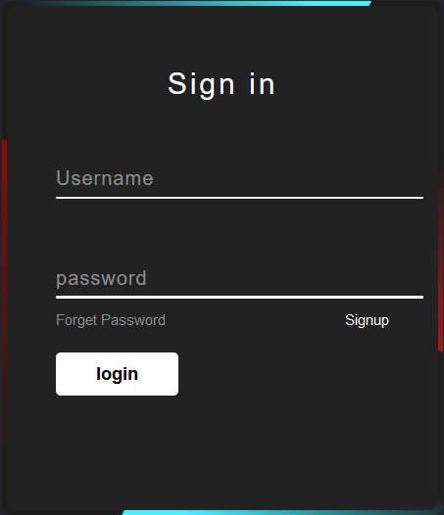
Name of the School: School of Computer Science and Engineering
Course Code: E1UA307C Course Name: Java programming
Login page

Slide 6
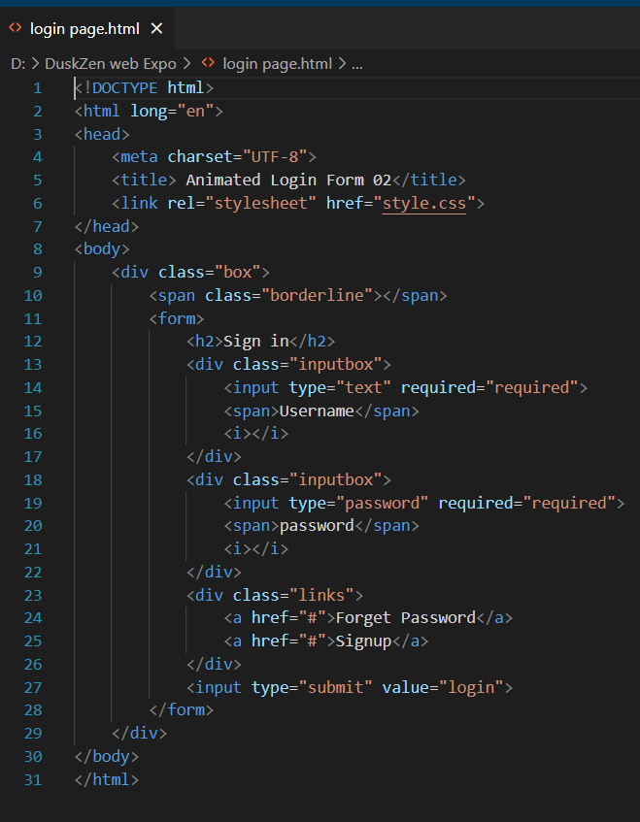
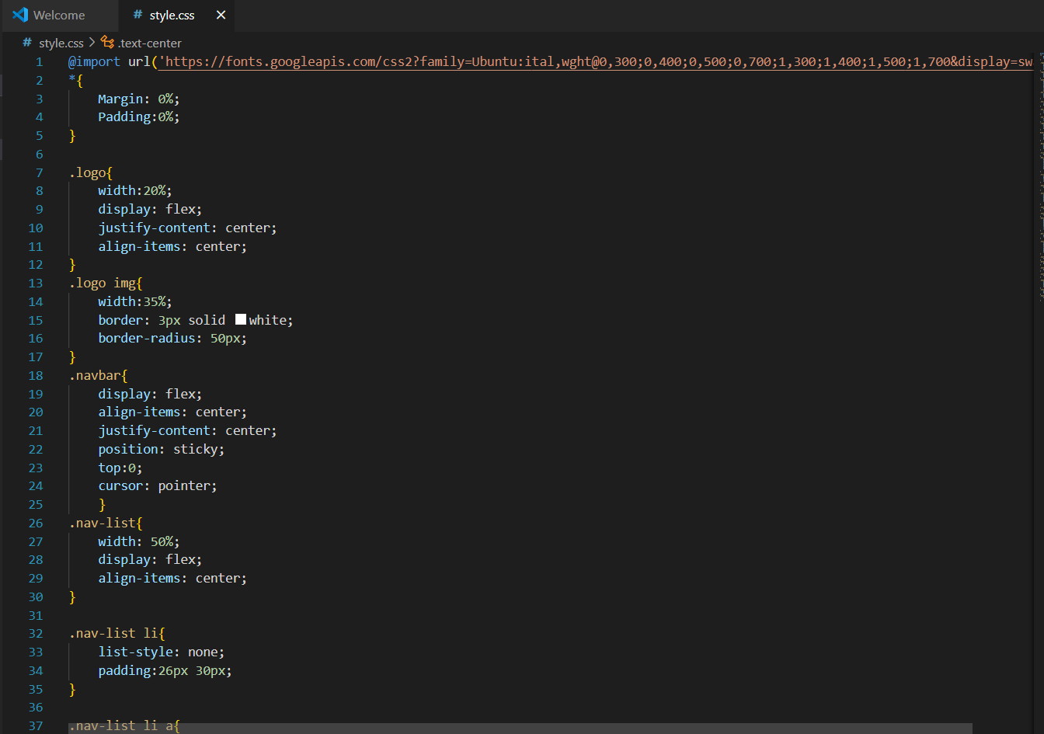
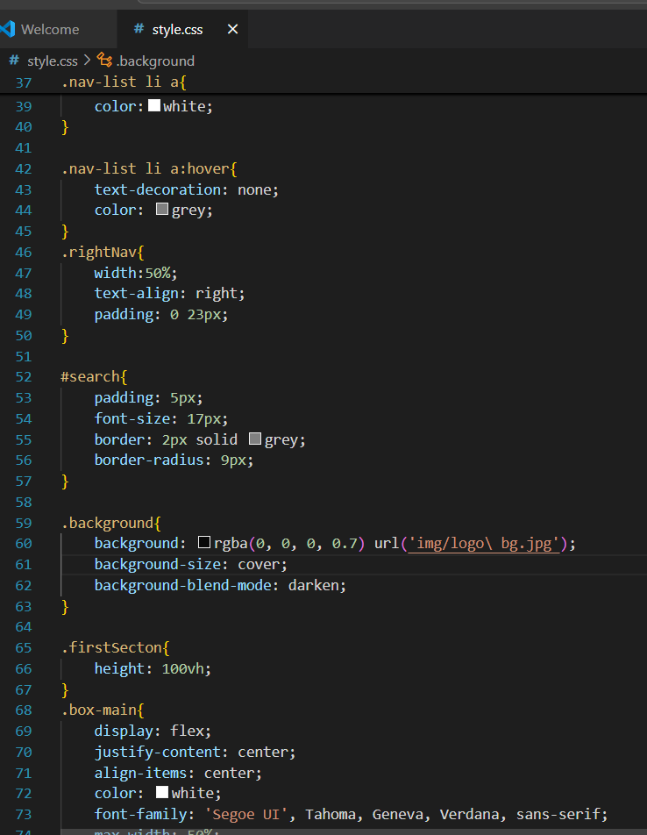
Name of the School: School of Computer Science and Engineering
Course Code: E1UA307C Course Name: Java programming
HTML CSS Code for Login page

Slide 7
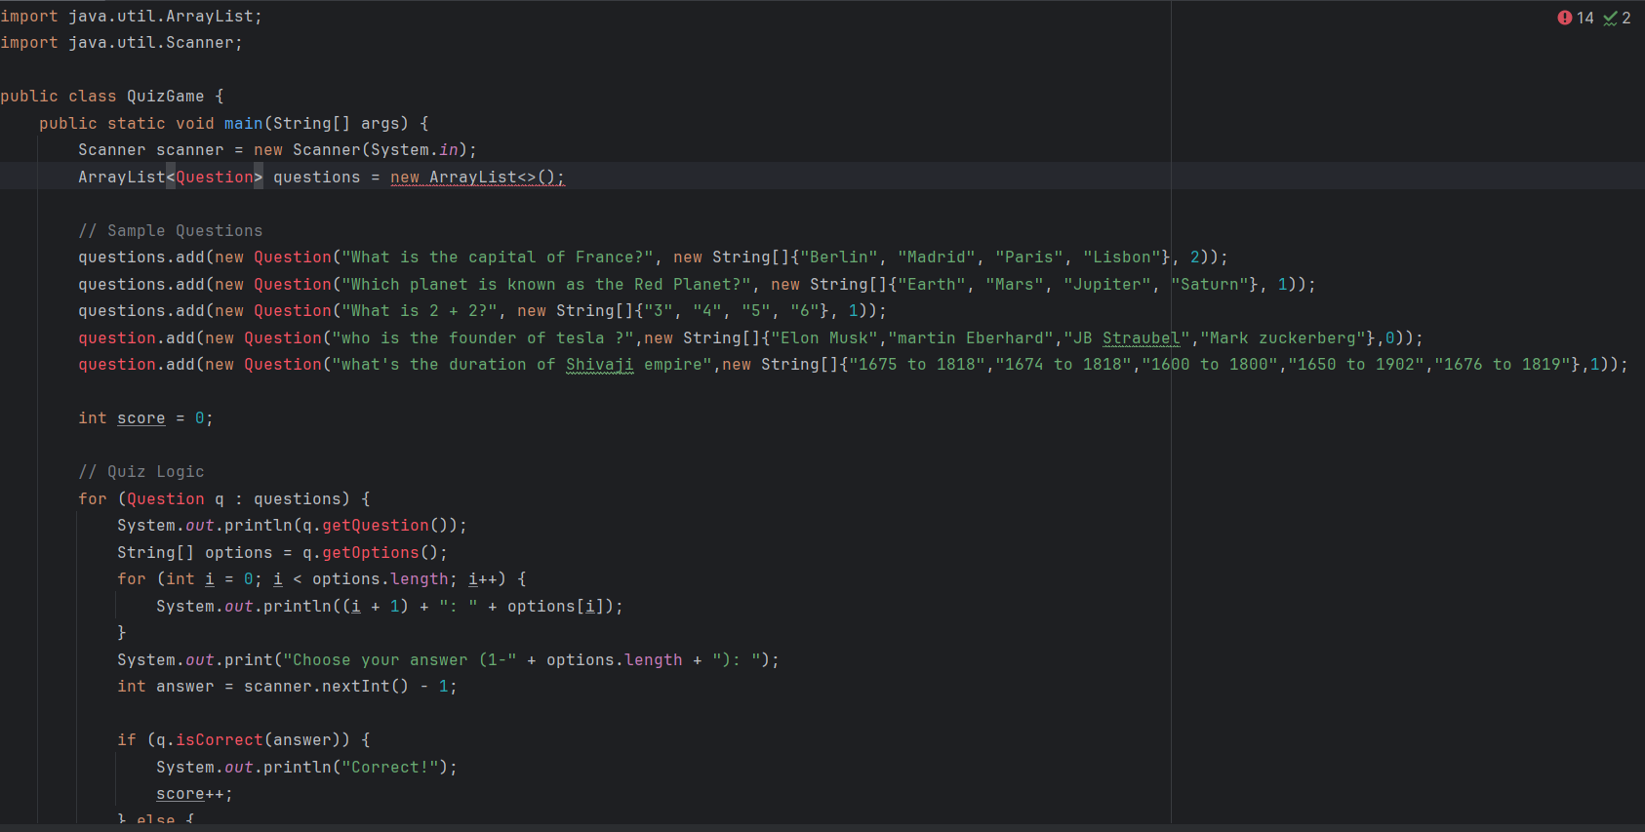
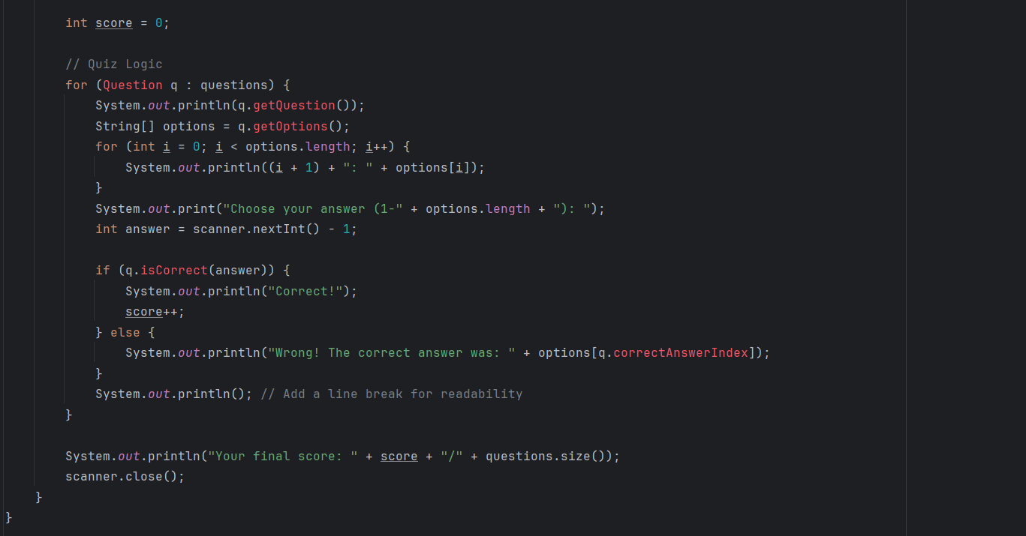
Name of the School: School of Computer Science and Engineering
Course Code: E1UA307C Course Name: Java programming
Technology Used JAVA Code

Slide 8
Name of the School: School of Computer Science and Engineering
Course Code: E1UA307C Course Name: Java programming
Conclusion
Project Scope and Features:
The quiz game allows users to register, participate in quizzes, and track their scores.
Key features include user authentication, a scoring system, and a collection of multiple-choice questions across various topics.
Extensibility:
The game can be expanded with additional features such as:
A leaderboard to track high scores.
Different quiz categories (e.g., Science, History).
A timer for added challenge.

